Slide 1
Qualitative Research I:
Introduction and Observational Techniques

Slide 2
Overview
Uses of Qualitative Research
Forms of Qualitative Research
Observational Research Techniques
Text Mining
Consumer Ethnography
Pros and Cons of Observational Research

Slide 3
Uses of Qualitative Research
Obtain preliminary ideas about consumer perceptions of a topic
Discovery! Identify unanticipated problems and opportunities
Generate possible explanations (hypotheses) about a market trend
Test new product, package, ad concepts
Provide input to questionnaire design

Slide 4
Common Forms
Observation
Focus Groups
Individual Depth Interviews

Slide 5
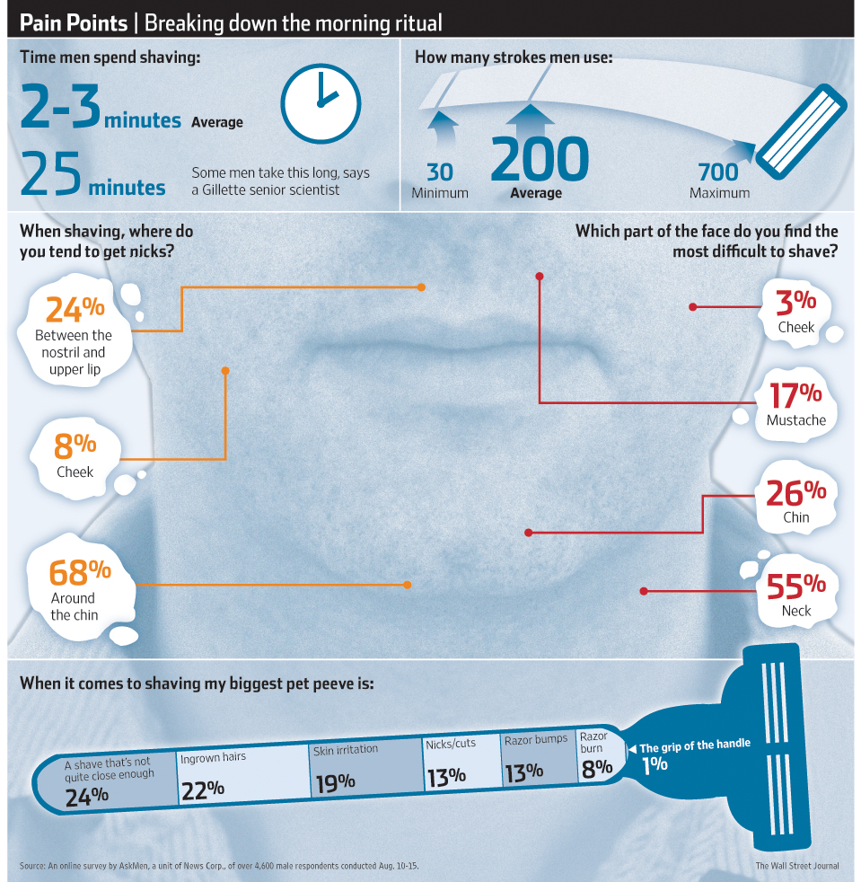
Observational Research
Dimensions of Observational Methods:
  Natural vs. Staged
  Disguised vs. Undisguised
  Structured vs. Unstructured
  Human vs. Technology

Slide 6
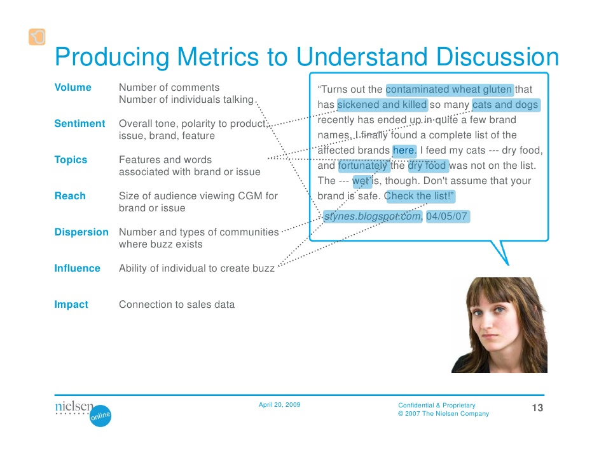
Social Listening

Slide 7
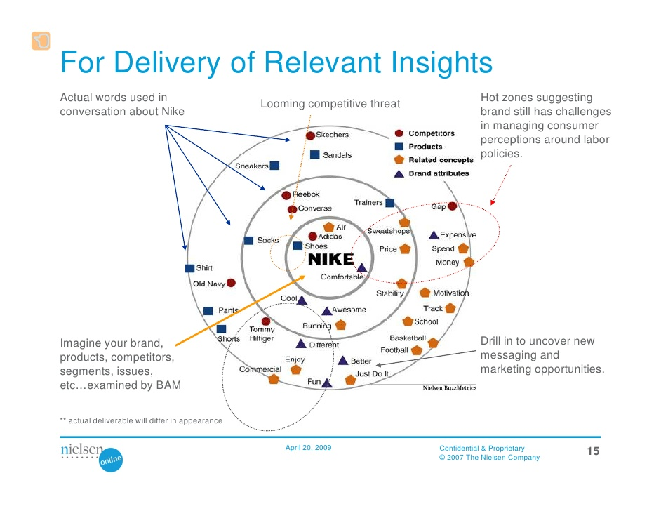
For Delivery of Relevant Insights

Slide 8
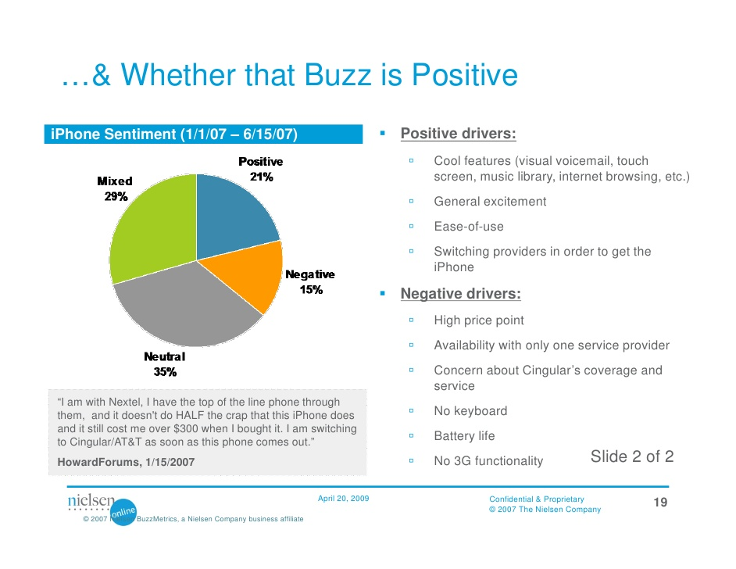
…& Whether that Buzz is Positive

Slide 9
Text Mining
Most applicable to C2C data
Most useful for detecting common brand associations
Many tools available, of varying complexity
Demonstration of a very simple tool

Slide 10
Example
www.ratebeer.com
  Corona Extra
  50 most recent ratings
www.wordclouds.com

Slide 11
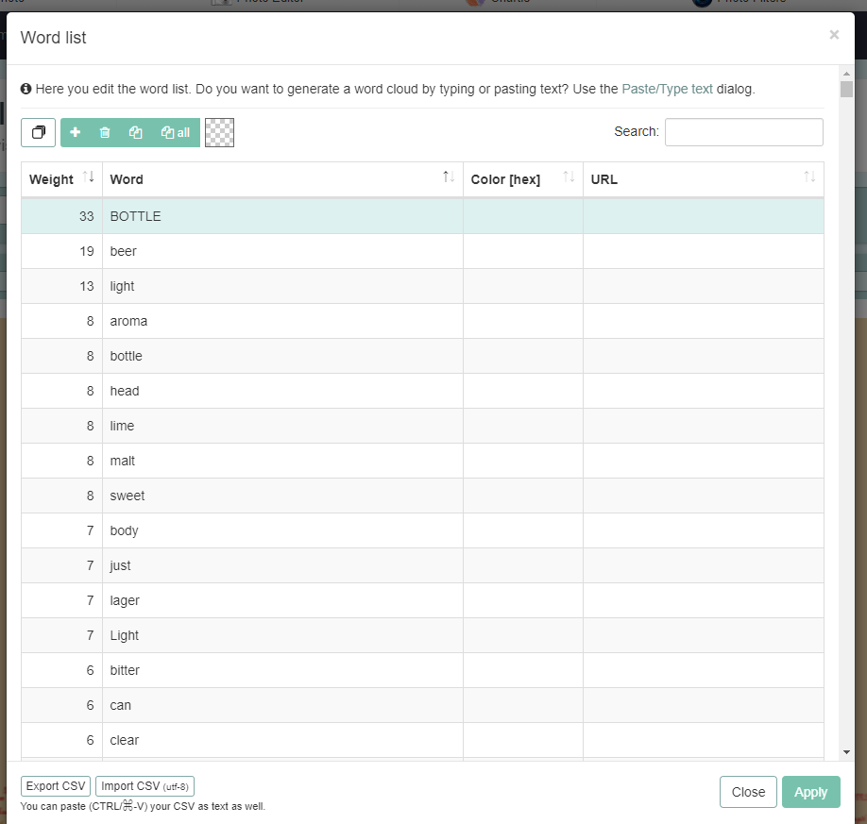
Simple Word Frequency List

Slide 12

Word Cloud Result

Slide 13
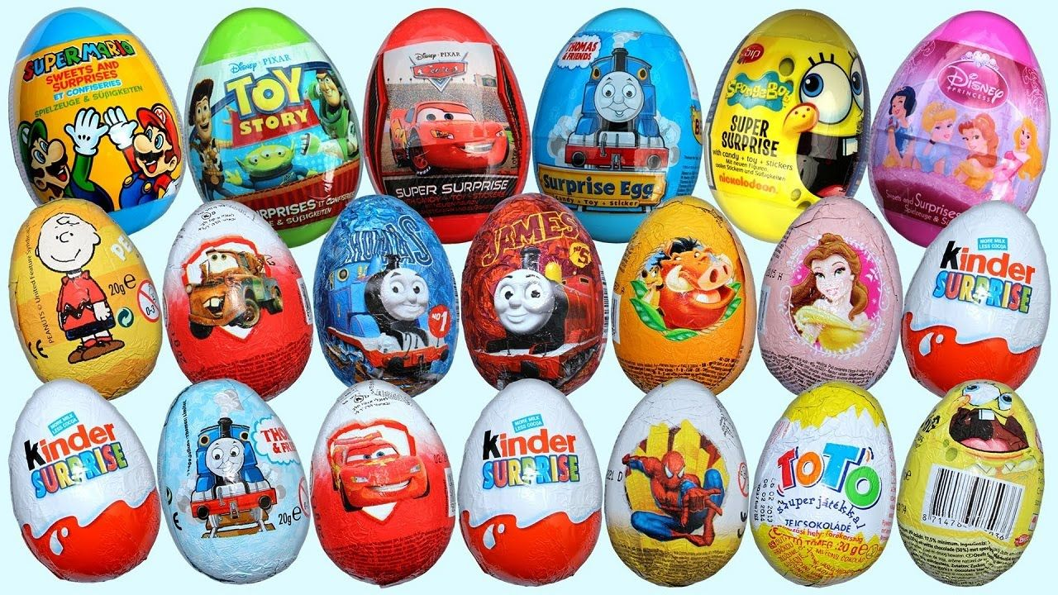
Observational Techniques: Consumer Ethnography
In-home interviews
In-field observation
  Personal
  Electronic

Slide 14
Observation: Pros
Major Advantages:
Ability to observe actual marketplace behavior.
  People do not always remember what they actually do.
  People sometimes misrepresent what they do.
“Discovery” of unanticipated phenomena

Slide 15
Observation: Cons
Major Disadvantages:
Depends on researcher’s interpretations.
  Without inquiry, researcher must infer motives
Must wait for target behavior to happen
  Risk of idle time

Slide 16
Conclusion
Does your firm use qualitative research?
Are there any current challenges facing your firm where observational research could potentially yield important insights?

Slide 17
End of Lecture

